Slide 1
Object Oriented Programming (CO203)
by
Ms. Disha Dua

Slide 2
Inheritance
An important feature of C++
The ability of a class to derive properties and characteristics from another class
Inheritance is a feature / process in which new classes are created from existing classes
New class created is called “derived class” or “child class” or “sub class”,
Existing class is known as the “base class” or “parent class” or “super class”

Slide 3
Why Inheritance?
Code reusability: helpful in reducing redundancy & error In case where functions are same for a number of similar classes, making separate functions for all of them leads to data redundancy with higher chances of error. Create a base class & adding reusable functions to it & then creating derived classes from it reduces both problems.
Transitive nature: helpful in debugging In case a derived class B inherits its properties from the base class A. Now, because of the transitive nature of the inheritance, all classes derived from B will inherit properties of the class A as well. This helps in debugging to a great extent as removing bugs from base class will debug all inherited classes

Slide 4
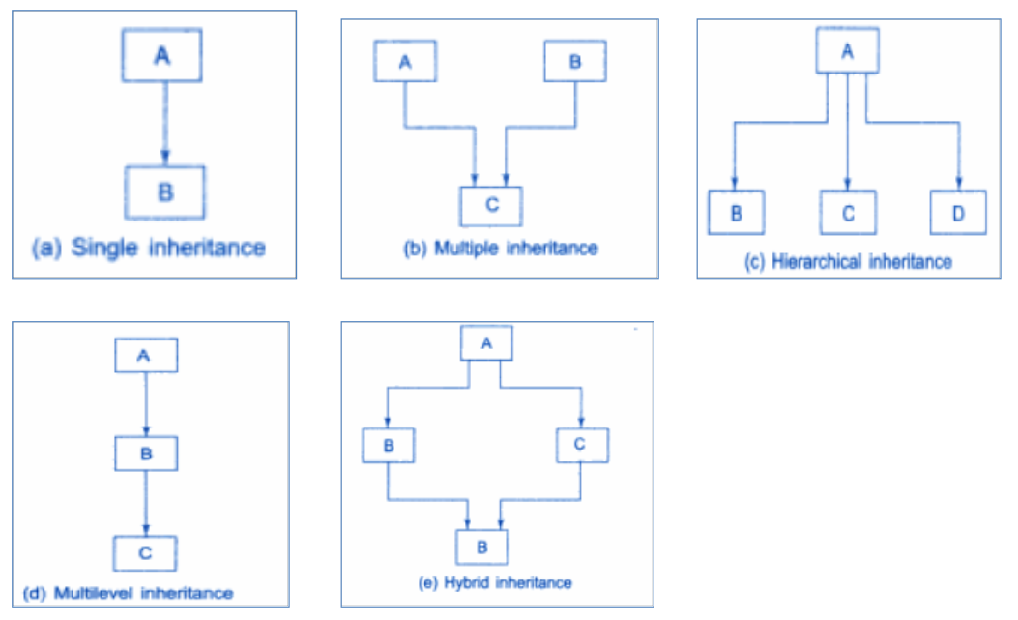
Inheritance - Types
As discussed in last class (29.08.2022)

Slide 5
Inheritance - Syntax
Syntax for defining the derived class and base class in all types of Inheritance in C++ is:
class base_class
{
//class definition of base class
};
class derived_class : visibility_mode base_class
{
//class definition of derived class
};

Slide 6
Inheritance - Modes
Public Mode: On deriving a subclass from a public base class, the public member of the base class will become public in the derived class and protected members of the base class will become protected in the derived class & private members of the base class will not be inherited
Protected Mode: On deriving a subclass from a Protected base class, both public members and protected members of the base class will become protected in the derived class
Private Mode: On deriving a subclass from a Private base class, both public members and protected members of the base class will become Private in the derived class

Slide 7
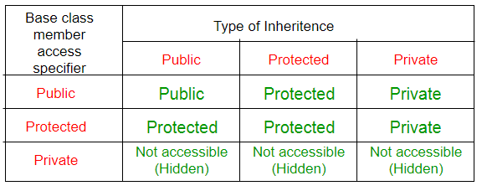
Inheritance - Modes

Slide 8
Inheritance - Modes
1. class ABC : private XYZ //private derivation
{ }
2. class ABC : public XYZ //public derivation
{ }
3. class ABC : protected XYZ //protected derivation
{ }
4. class ABC: XYZ //private derivation by default
{ }

Slide 9
Visibility Modes - Public Visibility Mode:
Retains accessibility of all members of the base class
The members specified as public, protected, and private in the base class remain public, protected, and private respectively in the derived class
Public members are accessible by the derived class and all other classes
Protected members are accessible only inside derived class and its members
Private members are not accessible to the derived class.

Slide 10
class base_class
{
private:
//class member
int base_private;
protected:
//class member
int base_protected;
public:
//class member
int base_public;
};
class derived_class : public base_class
{
private:
int derived_private;
// int base_private;
protected:
int derived_protected;
// int base_protected;
public:
int derived_public;
// int base_public;
};
int main()
{
// Accessing members of base_class using object of the //derived_class:
derived_class obj;
obj.base_private; // Not accessible
obj.base_protected; // Not accessible
obj.base_public; // Accessible
}

Slide 11
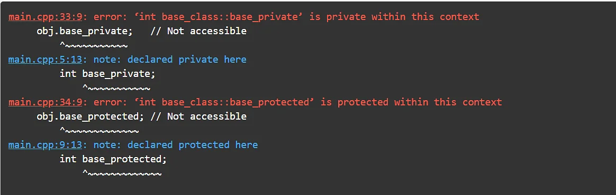

Slide 12
Visibility Modes - Private Visibility Mode:
All members of the base class become private in the derived class
This restricts the access of these members outside the derived class, and can only be accessed by the member functions of the derived class
In this case, the derived class does not inherit the private members.

Slide 13
class base_class
{
private:
//class member
int base_private;
protected:
//class member
int base_protected;
public:
//class member
int base_public;
};
class derived_class : private base_class
{
private:
int derived_private;
// int base_private;
// int base_protected;
// int base_public
protected:
int derived_protected;
public:
int derived_public;
};
int main()
{
// Accessing members of base_class using object of the derived_class:
derived_class obj;
obj.base_private; // Not accessible
obj.base_protected; // Not accessible
obj.base_public; // Not Accessible
}

Slide 14
